Slide 1
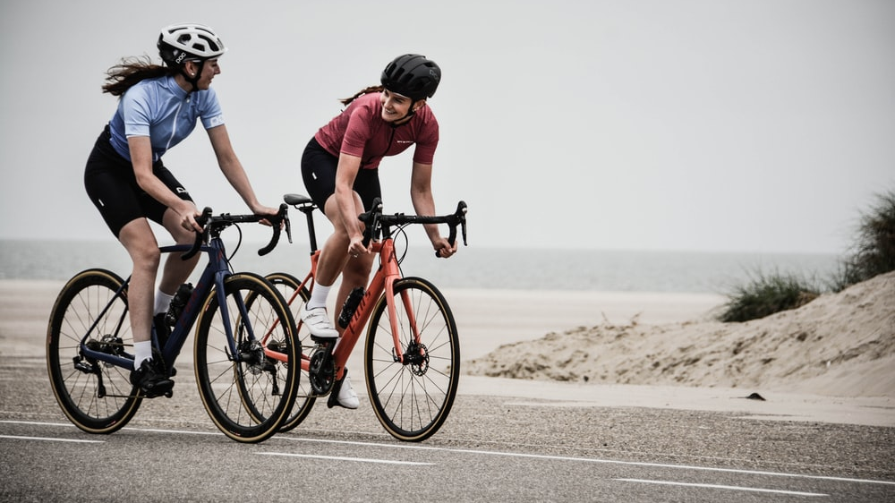
ADVENTURE HARDWARE G
DATA VISUALIZATION & FORECASHING
DELIVERED BY SAMUEL ATAM ON BEHALF OF PAIRVIEW LIMITED

Slide 2

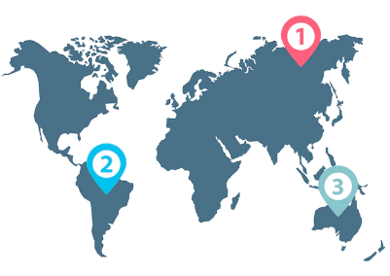
Table of Contents
AHG
1
Business Overview
Executive Summary
Financial and Demographics performance
Market Share & Competitors
Market Basket Analysis
5 Years Sales Forecast
AHG Strategy
Conclusion, Recommendation & Acknowledgements
2
3
4
5
6
7
8

Slide 3
Business Overview
1
AHG
Adventure Hardware Group (AHG) is a global manufacturing organization with operations in America, Europe, and Asia. AHG is an online specialty retailer and reseller of Road bikes, Mountain bikes, Touring bikes, components, accessories, and clothing (Cycling products). We deliver the personalized service of the best local shops, but with a dynamic, interactive experience only possible on the web – specially designed to make you knowledgeable and confident about every product we sell.
4 Years in Business
10 Regions
2 Channels
(Online & Reseller)
3 types of Bikes
35 Sub- Categories
18,040
Customers

Slide 4
2
Executive Summary
AHG
AHG is an established bicycle specialty store, offering retail sales of new bicycles, parts and accessories, clothing, and component.
This analysis shows the financial plan using a business intelligence tool. This fact-finding is to ascertain how AHG has been experiencing a shift in the marketplace towards digital as well as a change in customer demographic, possibly leading to declining in its store sales.
This report shows that Across the globe, AHG sales have grown 98% from the end of 2011 to 2013 (62% Online and 118% Reseller).
There is a clear drift between May 2013 and July 2013, With Australia leading the regions with 35.79% of profit, the percentage of Online transactions increased by 360%.
This shift was achievable by introducing product categories like Accessories and clothing, which were widely accepted and increased transaction sales. Additionally, as of November 2013, a change in the bicycle segment is seen, surpassing online sales to reseller channels.
To have a comprehensible discernment, the use of charts were used to understand the analysis in Customer Demography like Income Earners, Gender, Occupation, Marital status, Commuter Distance, No of Children, and Education. The highest volume of sales (%) was recorded in Education.

Slide 5
2
Executive Summary
The Bike Sales represent 86.1%. It is distributed by the following channels.
- Online: it represents 26.60% of sales, however, the profit represents 118% of total sales.
- Reseller: It represents 73.40%, however, the profit is negative for 118% of total sales.
Australia is the region with the highest online sales since 2011 with a total of 8.21% of total online sales and the South-west in the US is the region with the highest reseller sales since 2Q-11 with a total of 16.85%.
Competitor Analysis was used to examine AHG competitors’ features, market share, pricing, marketing, differentiators, strengths, weaknesses, geography, culture, and customer reviews.
5 - year forecasts: - Online: UK, France, Germany, Southwest US, Northwest US, Canada, Australia, and Southwest US show an increment of 134%, 135%, 127%, 89%, 85%, and 56% respectively in revenue. Central is practically NULL. - Reseller: UK, France, Northwest US, Southwest US, and Central US show an increment of 114%, 46%, 42%,&1, and 98% respectively. Australia and Germany 5 Year forecasts are not reliable.
Market Basket Analysis The Product to be sold together based on profitability are the following:
Transactions that include Hydration Pack>
Bike Wash/Classic Vest/12% Hitch Rack
Transactions that include Mountain Tire Tube>
Mountain Tires/Fender Set/Water Bottle Cage Water Bottles
AHG

Slide 6

Table of Contents
AHG
Financial and Demographic Performance

Slide 7
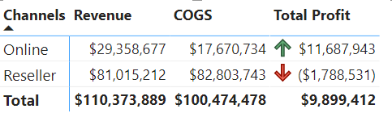
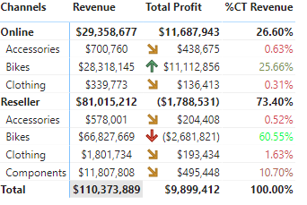
3.1
Summary of Financial Info – Data from May 2011 to June 2014
AHG
Revenue, Cost & Profit by Channels
Product Category Sales & Profit by Channels
Comments
Reseller: it represents73% of sales, however, the profit is negative.
Online: it rrepresents27% of sales, however, the profit is positive +124%.
Bikes Category it represents 86% of the sales and the online market is the only one profitability.

Slide 8
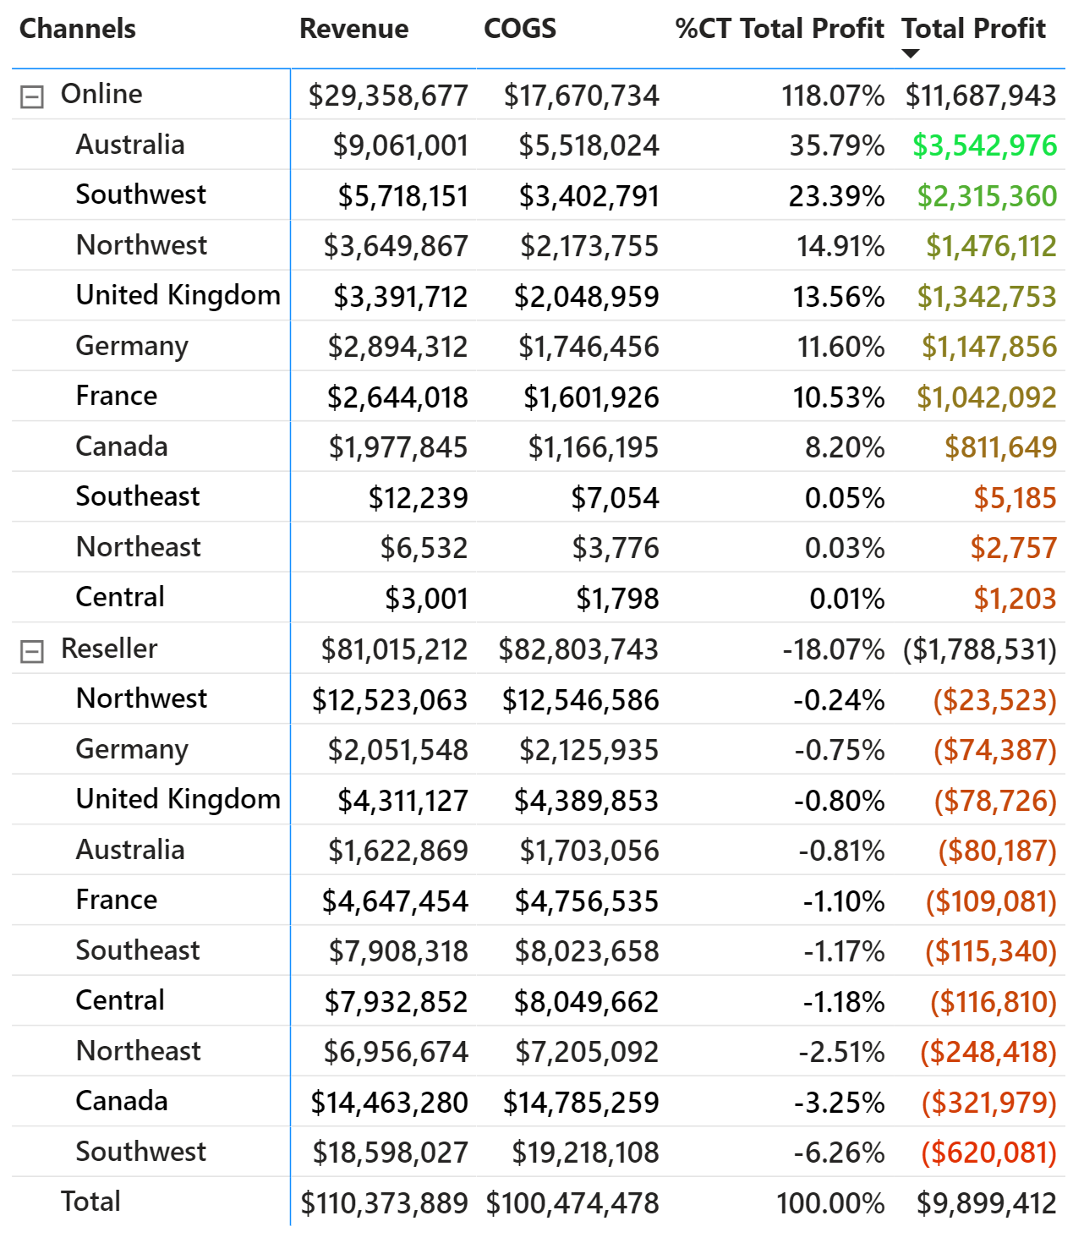
3.1
Summary of Financial Info – Data from May 2011 to June 2014
Region sales & Profit Channels
AHG
Comments
Regions:
Online Market - Australia is the largest seller with 8.21% ($9M) of sales being also the most profitable region with 35% ($3.5m) of the total profit.
Reseller Market - The combination of regions in the US and Canada have the largest sales by difference (84% of Total Sales). Overall there is no profit in Reseller Market with 18% profit loss.

Slide 9

3.2
Is there a shift towards Digital?
AHG
YES

Slide 10
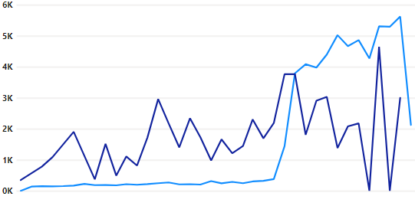
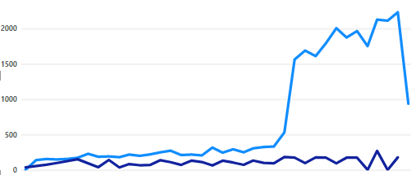
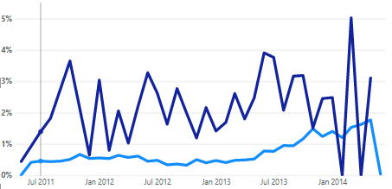
3.2
Is there a shift towards Digital?
Volume of Sales, Items Sold & Transaction by Channels YoY
AHG
Online
Reseller
Sales
Comments
There is a clear shift between May 2013 and July 2013. The number of Online Transactions increased rapidly.
In July 2013, the number of sales online exceeded the number of reseller sales for the first time.
In June 2013 against May 2013, the increase of online sales was 48%.
Transactions
Items Sold

Slide 11
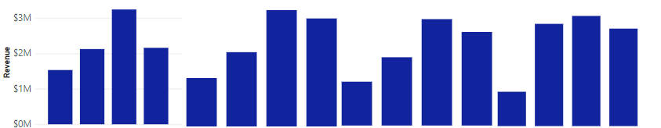



3.2
Is there a shift towards Digital?
What is driving the Shift? By Regions:
AHG
Southwest
(US)
Northwest
(US)
United
Kingdom
Northwest
(US)
Central (US)
Southeast
(US)
Australia
Canada
France
Germany
6M
4M
2M
0M
Online
Revenue
6M
4M
2M
0M
Reseller
Revenue
2011
2012
2013
2014
2011
2012
2013
2014
2011
2012
2013
2014
2011
2012
2013
2014
2011
2012
2013
2014
2011
2012
2013
2014
2011
2012
2013
2014
2011
2012
2013
2014
2011
2012
2013
2014
2011
2012
2013
2014
Comments:
The Reseller sales was down which made the Online sales soar . Generally, 2014 had a negative effect on AHG sales.
Australia had a better conversion from reseller to online market.

Slide 12
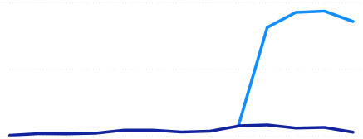
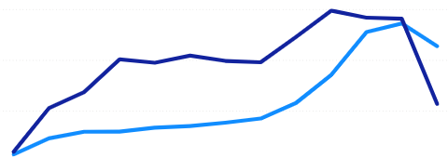
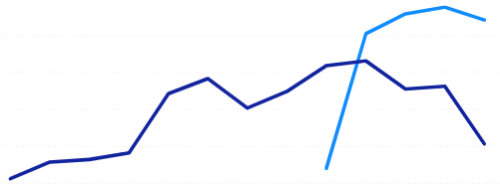
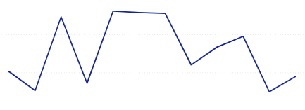
3.2
Is there a shift towards Digital?
What is driving the Shift? By Product Category:
AHG
Volume of Sales by Product Category YoY
Online
Reseller
Product Categories
Accessories
Sales
3k
2k
1k
0k
Online
Accessories
July 2013
Bikes
3k
2k
1k
0k
Sales
Online
Clothing
July 2013
3k
2k
1k
0k
Clothing
Sales
3k
2k
1k
0k
Sales
Component
Comment
There is a shift towards online market for bikes and Accessories trending upwards in April 2013 rising by 195% and 771% respectively. The Component segment recognized a new market in the Online sales channel.
2012
2013
2014

Slide 13

AHG
Financial and Demographics Performance
Is the Business Making Profit?

Slide 14
3.3
Is the business making profit?
AHG
RELATIVELLY

Slide 15
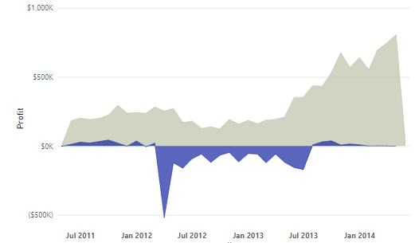
3.3
Is the business making profit?
AHG
AHG – Profit by Channels YoY
Channel
Online
Reseller
Comments:
Online: The online measure report shows growth from $175K in June 2011 to $809k in May 2014, ﻿Total Profit for Online (349.89% increase) and Reseller (20.59% increase) both trended up between May 2011 and June 2014.
Reseller: The report shows a continuous decline in monthly profit. ﻿Total Profit for Reseller started trending up in June 2013, rising by 105.24% ($163,956) in 2 months

Slide 16
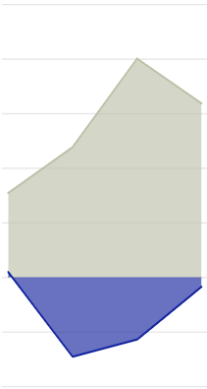
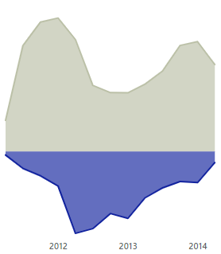
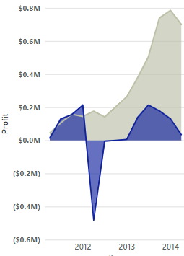
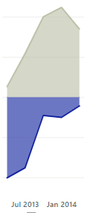
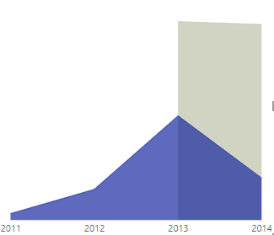
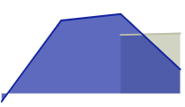
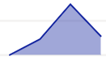
Is the business making profit?
3.3
Channel
Online
AHG- Product Category Profit by Channels YoY
AHG- Bike Category Profit by Channels YoY
Reseller
AHG
Accessories
Bikes
Clothing
Components
Mountain Bikes
Road Bikes
Touring Bikes
5M
4M
3M
2M
0
(0.01M
(0.2M)
Profit
2011
2012
2013
2014
2011
2012
2013
2014
2011
2012
2013
2014
2011
2012
2013
2014
Comments
Bikes Market Reseller:﻿Total Profit for Reseller started trending up in January 2013, rising by 491.84% ($28,986) in 5 quarters.
﻿Total Profit for Reseller started trending up in January 2013, rising by 491.84% ($28,986) in 5 quarters.
Total Profit for Online (1,424.55% increase) and Reseller (134.39% increase) both trended up between April 2011 and April 2014.﻿

Slide 17
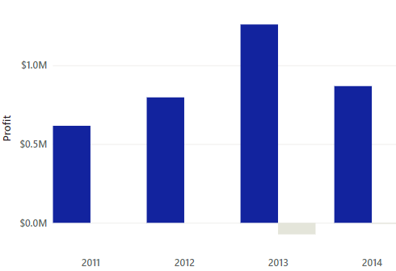
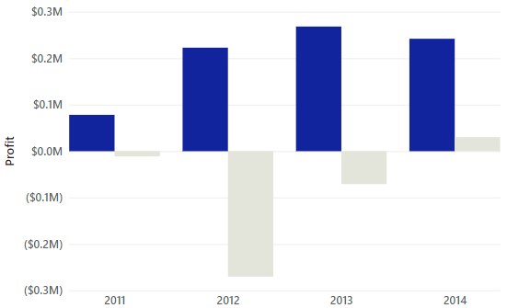
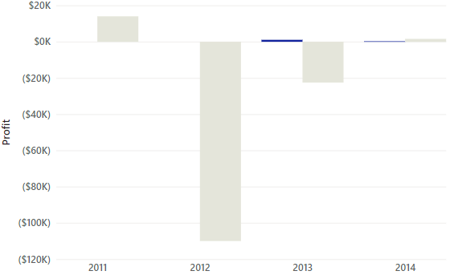
3.3
Is the business making profit? - Region
AHG
Channels
Online
Reseller
Australia
(1,815,409)
Canada
Central (US)
Reseller
(139,498)
Reseller
(299,619)
Comments:
﻿Online: Australia made up 97.79% profit, while ﻿Canada made up 71.60% of Total Profit.
﻿

Slide 18
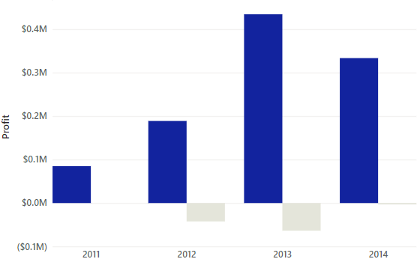
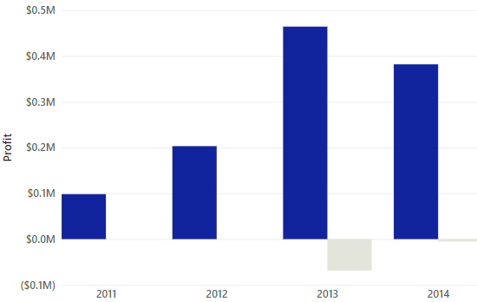
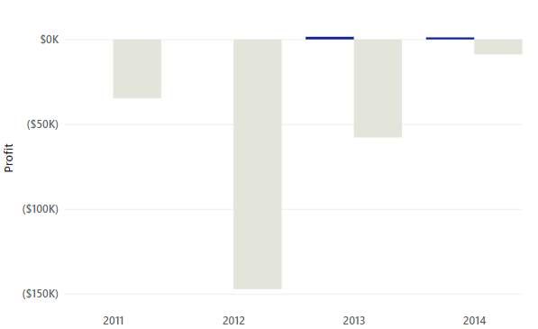
3.3
Is the business making profit? –
Region
AHG
Channels
France
Germany
North -East (US)
Online
Reseller
﻿ ﻿﻿ ﻿﻿Comment:
North-East US had The most recent Profit anomaly in 2012 when Reseller had a low of ($147,168).﻿﻿ Reseller (74.57% increase) trended up while Online (22.30% decrease) trended down between 2011 and 2014﻿.
France: Online (292.65% increase) and Reseller (92.46% increase) both trended up between 2011 and 2014.﻿﻿ ﻿﻿Profit for resellers started trending up in 2012, rising by 92.46% ($39,099) in 2 years.﻿﻿ ﻿

Slide 19
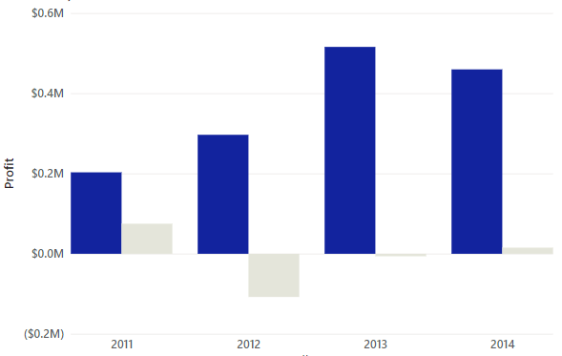
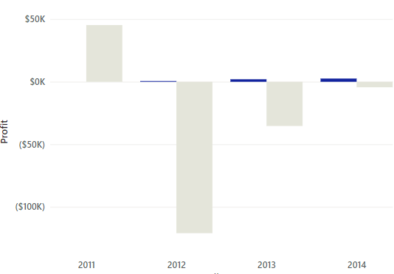
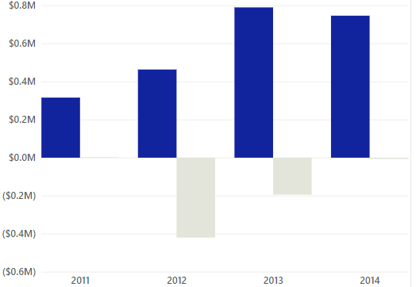
3.3
Is the business making profit? - Region
AHG
Channels
Online
Reseller
North-West(US)
South-East(US)
South-West(US)
Reseller
(150,512)
Comment:
South-east Online (335.94% increase) trended up while Reseller (109.66% decrease) trended down between 2011 and 2014.﻿Profit anomaly was in 2012 when Reseller had a low of ($120,996).﻿
North-West Us: Online (126.39% increase) trended up while Reseller (79.62% decrease) trended down between 2011 and 2014.

Slide 20
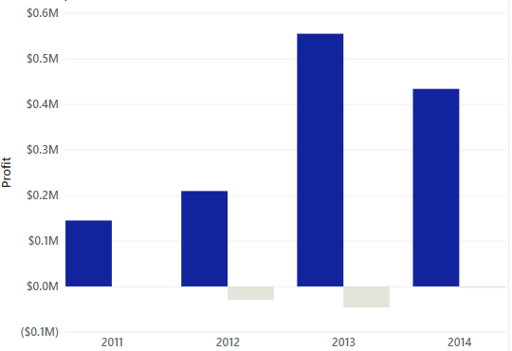
3.3
Is the business making profit? - Region
AHG
United Kingdom
Channels
Online
Reseller
Comments
The UK experience an increase in online sales between 2012 and 2013 with a 199% increase. Total Profit for resellers started trending up in 2012, rising by 90.34% ($26,664) in 2 years.

Slide 21

3.4
Table of Contents
AHG
Customer Demographics - Online

Slide 22
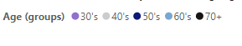
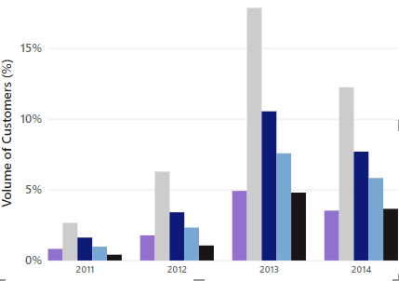
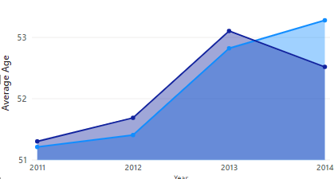
3
Customer Demographics - Online
AHG
YoY Volume of Customers and Sales by Age Group
Average Age of Customer YoY
53,024
52,929
51,699
Comments
﻿Across all metrics, Average Age had the most interesting recent trend and started trending up in 2011, rising by 4.05% (2.07) in 3 years.
NOTE: ﻿ ﻿﻿Average Age jumped from 51.24 to 53.31 during its steepest incline between 2011 and 2014.
The decline in sales over the year was seen in the Age group of 30’s ﻿

Slide 23
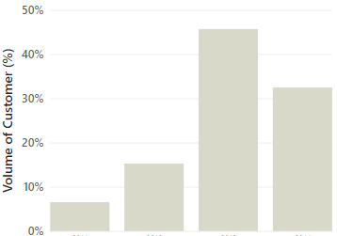
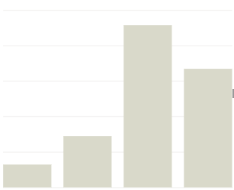
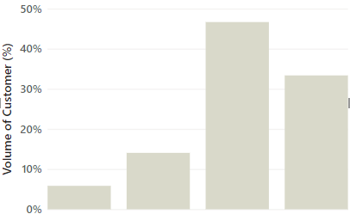
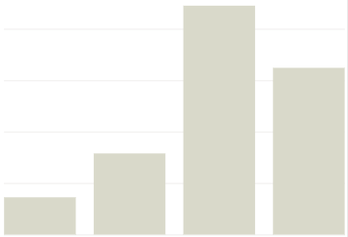
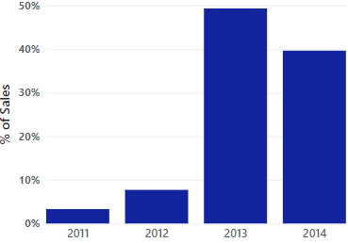
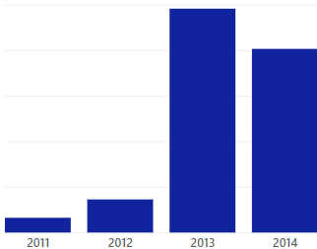
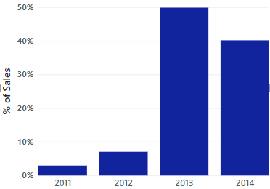
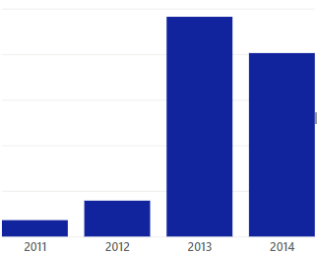
3.4
Customer Demographics - Online
Volume of Customer and Sales by Gender
Volume of Customer and Sales by Marital Status
AHG
Female
Male
Married
Single
Comments
Gender : The male accounted for 50.70% which was like the female.
﻿Marital Status: Married category accounted for 54.54% of customers

Slide 24
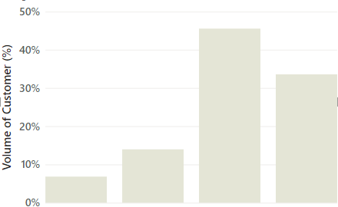
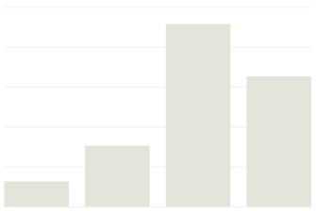
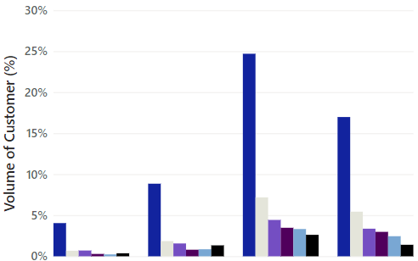
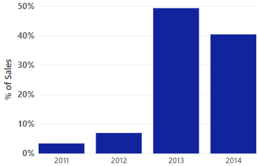
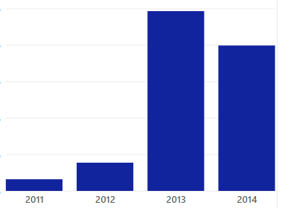
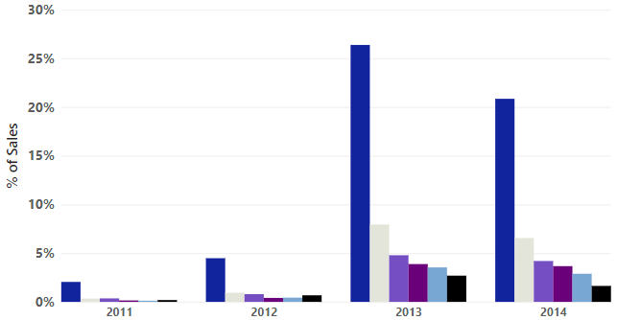
3.4
Customer Demographics - Online
AHG
Volume of Customer and Sales by House Owner
Volume of Customer and Sales by Total Children
0
1
2
3
4
5
Comments
The home-owners accounted for 67.28% of volume of customers although no significant changes over the years across No of Children

Slide 25
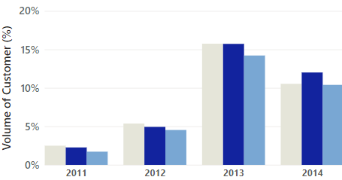
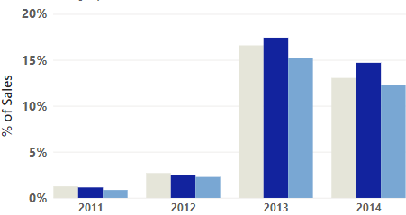
3.4
Customer Demographics - Online
Volume of Customer and Sales by Commute Distance
% of Sales Commute Distance
AHG
0-1 Miles
2-5 Miles
+5 Miles
0-1 Miles
2-5 Miles
+5 Miles

Slide 26





3.4
Customer Demographics - Online
Volume of Customer and Sales by Education
AHG
Bachelors
Graduate degree
High School
Volume of Sales %
Volume of Customer %
Partial College
Partial High College
Comments
﻿Education: Bachelors accounted for 28.23% which was hasn’t changed over the across the period.

Slide 27





3.4
Customer Demographics - Online
Volume of Customer and Sales by Occupation
AHG
Clerical
Management
Manual
Volume of Sales %
Volume of Customer %
Professional
Skilled Manual
Comments

Slide 28



3.4
Customer Demographics - Online
Volume of Customer and Sales by Income
AHG
High Income
Low Income
Mid-Income
Volume of Sales %
Volume of Customer %

Slide 29
3.5
Which areas AHG should improve?
AHG
Manufacturing
Total Budget and actual Manufacturing cost remained on changed YoY. AHG should carry out an inquiry for possible skullduggery.
Scrap Reason: “Drill size too large and Trim length too short” should be reviewed why it is above the average.
Days Delay Delivery: 33 % of Work Orders are Late.

Slide 30


3.4
-
Which areas AHG should improve?
Manufacturing
% Work Order by Scrapping Reasons YoY
AHG
2011
2012
2013
2014
Comments
Scrap Reason: Over the years the soaring high level of scrap demonstrates why a manufactured product may fail inspection and as a result impact of the company's manufacturing process.
Trim length too short and drill size too large should be reviewed why it is more than the average.

Slide 31

3.4
-
Which areas AHG should improve?
Manufacturing
Top 10 Products with Higher % of Scrap
AHG
Comments:
This survey shows that some products like Mountain-100 Black 42 at 0.63%, had the highest total scrap quantity and was 51.96% higher than ML Road Rear Wheel which carries potential manufacturing risks and can cost high level of manufacturing process.

Slide 32


3.4
-
Which areas AHG should improve?
Manufacturing
Scrap Quantity with Scrap Reason
AHG
Scrap Reason
Scrap Quantity
Top 20 Products with Higher Scrap Quantity
Comments:
Highest scrap quantity report shows that ML Crankset accounted for 13.60% of the product with higher Scrap quantity.
Trim too long has the highest scrap reason which should be reviewed.
NOTE: 18% of scrap value has a significant manufacturing loss to AHG. This should be reviewed.

Slide 33

3.4
-
Which areas AHG should improve?
Manufacturing
% Loss of AHG Manufacturing cost to Scrap value
AHG
Comments
8% of scrap value has a significant manufacturing loss to AHG
NOTE: To fully minimize scrap and waste, processes must be streamlined from end to end, beginning with the initial sales contact through the final delivery of the order. Mistakes or inefficiencies at any phase can result in unnecessary waste. AHG should Robust process control measures for identifying the causes of defects, ensuring adherence to design specifications.

Slide 34




3.4
-
Which areas AHG should improve?
Manufacturing
AHG
Total Budget & Actual Cost by Manufacturing Process
2011
2012
Total Budget
Actual Cost
Comments
﻿Total Budget and Actual Cost are positively correlated with each other across years.
NOTE: AHG should audit the manufacturing process for likely manipulation of expenses or fraudulent disbursements.
2013
2014

Slide 35

3.4
-
Which areas AHG should improve?
Manufacturing
Average Time To Manufacture
AHG
Comments:
Giving that the average time to manufacture is 8 Days, There are strict guidelines dictating the timeliness of certain packages.
with Certain goods in high demand, which is why they may need to be manufactured and delivered within strict timeframes.
NOTE: AHG timely manufacturing processes make for high customer and client satisfaction. Not only will receiving their goods on time lend brand credibility and acquire new customer.

Slide 36

3.4
-
Which areas AHG should improve?
Manufacturing
Annual Cost by Manufacturing processes in each Location
Comments
In 2013 AHG spent more in manufacturing locations YoY. Subassembly with 16.75% has the highest cost rate.
NOTE: For labor-intensive products and those requiring significant assembly work, AHG should make production costs reasonable so profit can be sufficient, then the business will be able to operate without incurring unsustainable debt.

Slide 37

3.4
-
Which areas AHG should improve?
Manufacturing
AHG Price Discount
AHG
Comment:
Price Below List Price: The bike category recorded the most significant price deduction in the reseller market compared to other products.
Discount: The margins are higher when selling Touring bikes, Mountain bikes, and road bike
and other products at full price, compared to selling at a discount.
NOTE: It's reasonable for customers to expect the best deal possible, but discounting creates a variety of problems for AHG. Ultimately, these problems can impact profit margin, customer satisfaction, and reputation so severely they may threaten AHG’s business.

Slide 38


3.4
-
Which areas AHG should improve?
Supply Chain
AHG
Top 10 Vendors with High RECEIVED Manufacturing ITEMS
Top 10 Vendors with High REJECTED Manufacturing Items
Comments:
﻿At 83,002, Capital Road Cycles had the highest received quantity and was 78.58% higher than Signature Cycles, which had the lowest received quantity at 46,480.
Capital Road Cycles accounted for 14.87% of Total received quantity
NOTE: AHG should continue to patronize vendors with high received quantity.

Slide 39


3.4
-
Which areas AHG should improve?
Supply Chain
AHG
Transportation Cost by Ship Method
Transportation Cost YoY
Comments
Transportation Cost : ﻿At 23,815.75, OVERNIGHT J-FAST had the highest Ship rate and was 923.65% higher than XRQ – Truck Ground, which had the lowest Total Ship Base at 2,326.55
NOTE: AHG should consider carrying out consolidated freight shipment, negotiate and build a better relationship with other carries so they can obtain discounts and reduce cost.

Slide 40

3.4
-
Which areas AHG should improve?
Supply Chain
Vendors Delivery Status of Manufacturing Items to AHG
AHG
Comments:
Late Delivery and Early Delivery diverged the most when the Vendor was Jeff's Sporting Goods, when Late Delivery were 7,850 higher than Early Delivery.﻿
AHG should reconsider doing business with vendors with late delivery status.

Slide 41

4
Table of Contents
AHG
4
Market Share & Competitors

Slide 42





Main Competitors by Regions
4
AHG

Slide 43


3.4
Market Share & Competitors - Online
AHG
Price Competitor Analysis Online – Mountain and Road Bikes in $
AHG’s prices are compared to others are rationally competitive apart

Slide 44



Market Share & Competitors - Online
AHG
Price Competitor Analysis Online – Revenue, Profit & Helmet

Slide 45

3.4
Market Share & Competitors
Competitors Analysis by Notable Features – AHG does not have
AHG
Notable Features
Late Delivery
Aging Infrastructure
Value for Money
Excellent Customer Service
Lack of Geographical Diversification
Negative Publicity
Product Review
Full Warranty
Easy Returns
Gift Cards & Discount
Product Diversity
Superior Products
Online Sales
Price Discount Offerings
Distribution Services
Post-Sale Customer Service System

Slide 46
4
Market Share & Competitors
Bikes Category by Company
AHG
Mountain
Bikes
Road
Bikes
Path &
Pavement
Company
Kids Bikes
Touring Bikes
BMX
City bikes E- Bikes Track Bikes
AHG Global
Cannondale
Bicycle Online
Bicycle Warehouse
Bike Depot
Halfords
Comments
Electronics bike is presented in all competitors. According to Grand View research ; By first quarter of 2017, hybrid bicycles are predicted to be the leading segment of global market and it is expected to account for over 14.2% share of the market in terms of value, accompanied by road and mountain segments. The hybrid bike is expected to reach valuation of US$ 28.75 Billion by 2025.
NOTE: Regions such as Europe and Asia are picking up where bicycles have dedicated lanes in cities and suburbs and witnessing a shift in customer motive for buying E-Bikes from leisure to daily use.

Slide 47

4
Market Share And Competitors - Online
AHG and Bike Sales by Region 2011 – 2015 ($)
AHG

Slide 48

Table of Contents
AHG
5
Market Basket Analysis

Slide 49










5
Market Analysis – ONLINE MARKET
Products that are frequently purchased together:
AHG
2
4
3
3
2
5
Mountain Tube
Mountain Bikes
2
Transactions that include Mountain Tire Tube>
32% Mountain Tires
18 % Fender Set
19% Water Bottle Cage and Water Bottles
Transactions that include Mountain bike>
32% Cycling Cap
18 % Mini Bag
12% Water Bottle Cage

Slide 50








5
Market Analysis – ONLINE MARKET
Products that are frequently purchased together:
AHG
2
3
4
Helmet
2
Transactions that includes Mountain Tire Tube>
22% Gloves
12 % short sleeve Logo jersey
Transactions that includes Helmet
Long sleeve jersey 31%
Full Gloves 12%

Slide 51





5
Market Analysis – ONLINE MARKET
Recommended joint purchases with joint profitability:
AHG
6
6
Mountain Bike
4
Road Bike
3
Transactions that includes Mountain Bike>
9% Socks
12 % Water Bottles cage
Transactions that includes Road Bike>
21% Fender Set
18 % Patch Kit

Slide 52









5
Market Analysis – ONLINE MARKET
Recommended joint purchases with joint profitability:
AHG
Hydration Pack
Women Mountain short
Transactions that include Hydration Pack>
32% Bike Wash
18 % Classic Vest
12% Hitch Rack
The transaction that includes Woman Mountain >
-9%Short- Mountain 400
-15% Short sleeve classic
-17% Half Finger Gloves & Racing Socks

Slide 53

Table of Contents
AHG
6
5 Years Sales Forecast

Slide 54






6
5 YEARS SALES FORECAST
AHG
France Online
UK Online
620,208
1,275,114
197,683
262,427
507,822
Comments
The Highest Quarterly sales was experienced in 1Q 2014, 262k in the UK, 197k in France.
The sales forecast in 5 years the UK, Germany and France shows significant increase of 136%. 127% and 140 respective in revenue.
213,915
Germany

Slide 55



6
5 YEARS SALES FORECAST
AHG
France Reseller Sales
United Kingdom Reseller
1,291,486
1,241,271
428,060
391,311
Comments
The highest Quarterly sales was in Q3 2013, where sales revenue $391k in France, $428k in UK
France & UK began sales in the 2Q 2012.
Germany sales began in the 2Q 2013 so in this case Forecast can not be estimate. However, Germany sales was 20% higher than UK and France in the 2Q of live.
The 5 Years Forecast of the UK and France shows an increment of 114% and 46% respectively in revenues.

Slide 56




6
5 YEARS SALES FORECAST
AHG
Canada Reseller
North-East
1,088,827
1,215,723
587,578
738,395
Northwest
• The highest quarterly sales in Northeast US was in the 3Q 2012, where sales revenue were $773k. And The highest quarterly sales in Northwest US and Canada was in the 3Q 2013, where sales revenue were 1,088k$ and $738k. • In 5 Years Forecast of the NE US, NW US and Canada shows an increment of 51%, 41% and 129% respectively in revenues.
1,205,051
773,889

Slide 57



6
5 YEARS SALES FORECAST
AHG
Canada Online
North-West Online
233,378
498,973
395,672
South-West Online
• The highest quarterly sales in Southwest US was in the 3Q 2012, where sales revenue were $400k. And The highest quarterly sales in Southeast US and Central was in the 1Q 2012, where sales revenue were $498k and 849k€. • In 5 Years Forecast of the SW US and Central shows an increment of 99% and 97% respectively in revenues. However, SE US shows a decrement of 45% in revenue.
655,919
400,001

Slide 58


6
5 YEARS SALES FORECAST
AHG
Australia
452,451
Comments
• The highest quarterly sales in Australia was in the 3Q 2013, where sales revenue were $452k.
The 5-year estimates are not reliable because the data period is short and there are numerous fluctuations.

Slide 59

6
5 YEARS SALES FORECAST
AHG
Online – 5 Years Sales Forecast
498,381
Australia
1,050,721
The highest quarterly sales was in the 1Q 2014, where sales revenue was $1.050k in Australia.
In 5 Years Forecast of the Australia shows an increment of 76% in revenues.

Slide 60

Table of Contents
AHG
AHG
7

Slide 61

7
AHG Strategy
AHG’s focal point strategy is to allow more target market segments to be reached via reseller channels.
Customers increasingly expect products to be available via more than one channel and this is tipped to
enhance higher revenues, Regions like Australia Germany, and France had better reseller performances. AHG’s reseller regions like Central US, Northeast US, and southeast should consider transferral to online channels for a duration to help with customer onboarding and acquisition to boost reseller channel. e.g., if retail outlets have no stock online then customers can buy via distribution stores.
Improved commitment to the Reseller E-Bicycle market. Reseller regions such as Central US Northeast US and the southeast US are witnessing a shift in customers’ motive for buying an E-bike from leisure to daily use.
With increasing demand for zero-emission climates. The e-bike market is tipped to generate around 53.5 billion U.S. dollars in revenue by 2027, with a compound annual growth rate of around 12.27 percent between 2016 and 2027.Prospective innovation for the future.
AHG should consider discontinuing business with the reseller channel. With $81k total revenue and COGS at $82k, and a negative profit of ($1,788).
This can occur if your sales increase comes from higher sales of low-margin items while you suffer a decrease in sales of high-margin products. Even during good times, it’s important to track your sales by margins, territory, distribution channel, and sales rep to spot trends that might lead to problems. If your profit margins aren’t rising, chances are your company isn’t thriving. Thus, AHG should close the Reseller channel till a better strategy for cash flow is available.

Slide 62

Table of Contents
AHG
8
Conclusion, recommendation & Acknowledgements

Slide 63
8
Conclusion
AHG
There is a clear drift, between May 2013 and July 2013, the number of Online transactions increased significantly by 370%.
The report discloses that while the reseller sales had a significant increase in overall revenue from 2011 to 214, the Online segment surpassed reseller sales first ever in 1 Quarter of 2014.
Clothing and Accessories segments were both introduced in May 2013, these segments had a significant shift from reseller sales to Online sales.
The Total reseller revenue of the bike segment represents 73.40% of Bike sales with a negative profit. These were a result of the reseller segment of Touring bikes and Road bikes experiencing a negative profit of £1.7Million.
The Reseller channel for Central US, Northeast US, and Southeast Market decelerate the growth and frightful Online sales.
The focal point for AHG should be on Gift cards and Discount offers to boost the online segment for the reseller channels.
Shipping cost: ﻿At 23,815.75, OVERNIGHT J-FAST had the highest Ship rate and was 923.65% higher than XRQ – Truck Ground, which had the lowest Total Ship Base at 2,326.55. AHG should consider carrying out consolidated freight shipments and negotiate to build a better relationship with other
carriers so they can obtain discounts and reduce costs.
Late Delivery diverged the most when the Vendor was Jeff's Sporting Goods when late Delivery was 7,850 higher than Early Delivery.﻿ AHG should reconsider doing business with vendors with late delivery status.
In relation to the Market Basket Analysis, The product that should be sold together to boost profitability is the following
MTT with Mountain tire/Finder set/Water bottle and water bottle cage.
Helmet with Long sleeve/Bike wash/Full Hand gloves.

Slide 64
8
Recommendations
Revenue for resellers started trending up, resulting in a 1,733.02% increase between April 2011 and April 2014. AHG should launch the Online Components Category market and cross-selling will increase sales.
To fully minimize scrap and waste, processes must be streamlined from end to end, beginning with the initial sales contact through the final delivery of the order. Mistakes or inefficiencies at any phase can result in unnecessary waste. AHG should Robust process control measures for identifying the causes of defects, ensuring adherence to design specifications
OVERNIGHT J-FAST had the highest Ship rate. AHG should focus on companies that offer cheaper and quality services like XRQ Truck Ground, they offer exclusive discounts on your port charges and besides carrying out all the documentation processes, allowing AHG time to focus on its core business.
Days Delay Delivery: 31% of work orders are Late; Turns out technology can provide a solution even in dire cases. AHG should consider web-based tracking, courier companies can locate and dispatch the nearest driver to the vehicle experiencing issues and relay all necessary packages to the end destination on time and in priority sequence.
The minimum price is higher than the average price of Road bikes and MTB. We propose a decrease in prices in order to penetrate the market. Rising prices will cause customers to reject your product or service in favor of cheaper alternatives.
Total Budget and Actual Cost are positively correlated with each other across different years. AHG should audit the manufacturing process for likely manipulation of expenses or fraudulent disbursements.
AHG

